Slide 1
WOMEN AND THE FRENCH REVOLUTION
Shailesh Saini 2021MT10925 Advait Rege 2021MT60946 Deepak Choudhary 2021MT10246
Rohit Bhaskar 2018CH70303

Slide 2
WHY REVOLUTION?
Economic hardship: The high cost of living, food shortages, and high taxes meant that women, particularly those from the lower classes, faced significant economic hardship. The Revolution offered the opportunity to demand change and relief from their struggles.
Legal Inequality- Women were considered second-class citizens and were denied many basic legal rights, such as the right to own property, sign contracts, or sue in court.
Lack of Education- Women were often denied an education, and if they were educated, it was usually limited to subjects like needlework, music, and etiquette

Slide 3
Marriage- Marriage was seen as a financial transaction, and women were often married off at a young age to men chosen by their fathers. Once married, women had few rights and were expected to be submissive to their husbands
Restrictions on Movement- Women were expected to stay in the domestic sphere and were not allowed to participate in public life. They were also subject to strict codes of moral behaviour and faced social restrictions on their ability to travel or attend public events
Political discontent: Women, like many other members of French society, were dissatisfied with the absolute monarchy and the lack of political representation. The Revolution presented an opportunity for women to voice their political opinions and demand change.

Slide 4


Slide 5
Female Citizens
The failure of the Declaration of the Rights of Men and Citizens to include women was intentional and not a sentiment shared by all
The Marquis de Condorcet published in 1790 the essay "On Giving Women the Right of Citizenship":
Responded to every objection posed to women's political equality including pregnancy, lack of educational brilliance, emotionalism, dependence on husbands, and the social problem society would face if women abandoned their domestic responsibilities to rule.
Logical and systematic response in the spirit of the Enlightenment.

Slide 6
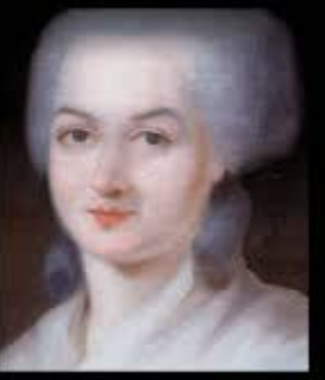
Some Revolutionary Faces
Olympe de Gouges
“Declaration of rights of women and citizens”
A French playwright and political activist, she wrote the famous Declaration shortly after passing the French constitution of 1791
Challenged the practice of male authority and the motion of male-female inequality
She was executed by guillotine during the Reign of Terror (1793-1794) for attacking the regime of the Revolutionary govt. and for her association with the Girondists.
Members of the Girondist political party tried to end the Reign of Terror

Slide 7

Mary Wollstonecraft
She was a british writer. In 1792, she wrote 'A Vindication of the Rights of Woman
She argued tirelessly that women were no less human beings than men and, as such, deserved the same fundamental rights - the rights of the Revolution.
Wollstonecraft revealed that the only reason some contemporary women are not naturally inferior to men and they appear to be just because of lack of education She suggests that both men and women should be treated as rational beings and imagines a social order founded on reason.
Counter attack on Bruke, who texted against the French working class who followed Marie Antoinette from Versailles to Paris.

Slide 8

Charlotte Corday
She went to political meetings and became inspired by the ideas of the Revolution and, in particular, the Girondin faction
The Girondins were a more moderate faction favouring a Constitutional government.
Assassinated Jacobin leader Jean-Paul Marat, who was in part responsible for the more radical course the Revolution had taken through his role as a politician and journalist
And was executed by guillotine for the murder

Slide 9
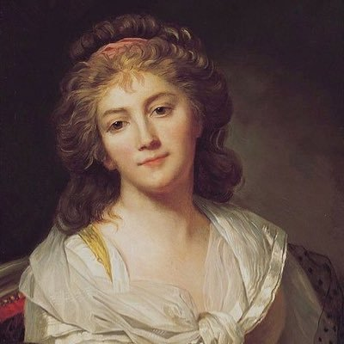
Pauline Léon
Pauline Léon was an influential woman during the French Revolution. She played an important role in the Revolution, driven by her strong feminist and anti-royalist beliefs.
A political activist and one of the leaders of the Society of Revolutionary Republican Women.
Léon was a strong advocate for women's rights and was involved in organizing and leading demonstrations for women's suffrage.

Slide 10
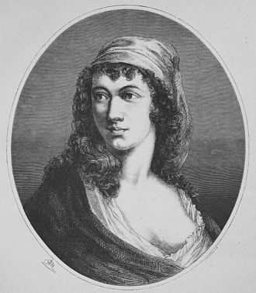
Théroigne de Méricourt
A political activist and orator, de Méricourt was known for her speeches and activism on behalf of women's rights. She was a key figure in the Society of Revolutionary Republican Women and was involved in organizing women's marches and demonstrations.
She was active in the French Revolution and worked within the Austrian Low Countries to also foster revolution. She was held in an Austrian prison from 1791 to 1792 for being an agent provocateur in Belgium.

Slide 11
Women as a public revolutionary force
Women were a public revolutionary force in the first months of 1789, although they could not vote nor seek seats in the National Assembly
Women participated in the attack on the Bastille and street demonstrations
Their most impressive demonstration of numbers was the 7,000 women seeking cheaper bread who walked to Versailles in October 1789 and forced the king and the National Assembly to return to Paris

Slide 12
During the Reign of Terror, women activists were arrested.
The Jacobins outlawed their clubs, believing that women belonged in the private sphere of the home, not in the public sphere of men.
Among the many who lost their heads to the guillotine was Olympe de Gouges, accused of "attacking the sovereignty of the French people."

Slide 13
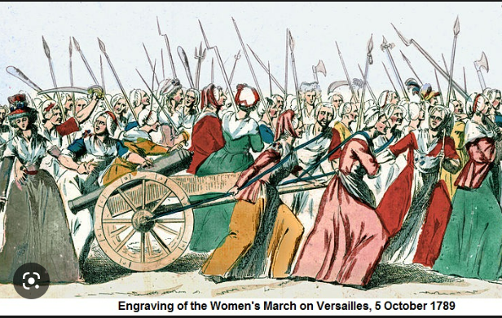

Slide 14
The Women's March
European women had a long tradition of rioting when they suspected speculators of hoarding food to drive up prices. Authorities seldom arrested the women rioters.
Frenchwomen's food riots, called taxation populaire, typically involved crowds seizing merchandise from shopkeepers and grocers, distributing it equally to the crowd at what they determined was a just price, and then returning proceeds to the merchants.

Slide 15
Women's Political Clubs
The most significant female participation in the French Revolution came with the advent of the women's political club.
Political clubs provided members with intellectual stimulation and a way to exert political pressure on the National Assembly, but none admitted women until January 1790, when The Confederation of the Friends of the Truth was founded.

Slide 16
Revolutionary-era women wanted
equality of rights within marriage
the right to divorce
extended rights of widows over property and of widowed mothers over their minor children
publicly guaranteed educational opportunities for girls (including vocational training for poor girls)
public training, licensing, and support for midwives in all provinces
guaranteed right to employment
and the exclusion of men from specific traditionally-female professions, like dress-making.

Slide 17
What they got...
Abolition of feudal obligations: The feudal system, which imposed a range of obligations and restrictions on the French population, was abolished during the French Revolution. This included the abolition of feudal duties and taxes, as well as the end of feudal privileges and the feudal courts.
Introduction of divorce: Divorce was introduced in France during the French Revolution, allowing couples to dissolve their marriages in a legal and straightforward manner. This was a significant change, as divorce had been difficult and rare in pre-revolutionary France.
Civil Constitution of the Clergy: The Civil Constitution of the Clergy, which was enacted in 1790, granted women the right to inherit property. This was a significant change, as women had previously been restricted in their ability to inherit property.
End of sumptuary laws: The sumptuary laws, which restricted women's clothing and behavior, were abolished during the French Revolution. This helped to challenge traditional gender roles and attitudes towards women

Slide 18
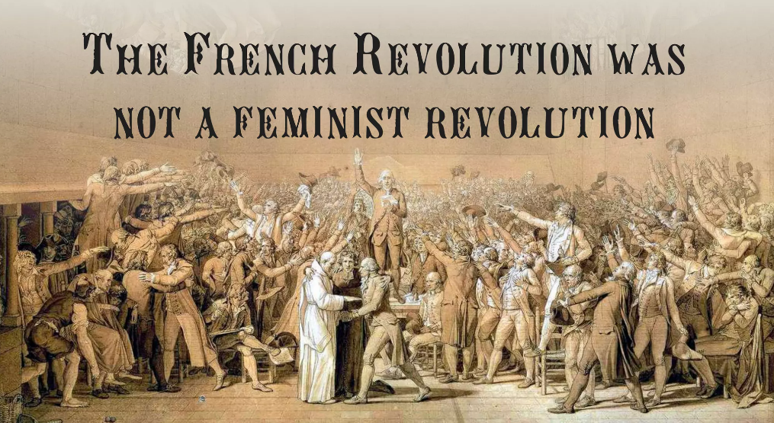

Slide 19
Aftermath of Revolution
The aftermath of the French Revolution with respect to women was mixed. On the one hand, some women made gains during the revolution, such as increased political and social visibility, as well as a greater sense of empowerment and agency. Women's clubs and societies, such as the Society of Revolutionary Republican Women, sprang up during the revolution, and women played an important role in the popular uprisings that took place.
However, these gains were largely short-lived, and after the revolution, women's rights and freedoms were significantly restricted. The Napoleonic Code of 1804, which established the legal framework for French society, reinforced patriarchal norms and denied women many of their rights, including the right to vote and to own property. Women were effectively relegated to the status of second-class citizens, and their contributions to the revolution were largely erased from the historical record.
In the decades that followed, the struggle for women's rights continued, with various movements and campaigns aimed at improving the status of women in society. However, it was not until the late 19th and early 20th centuries that the women's rights movement in France gained significant traction and led to meaningful legal and political changes for women.
Overall, while the French Revolution had a profound impact on the political and social landscape of France, its impact on women's rights was mixed, with some gains being made during the revolution, but these gains were largely rolled back in the aftermath.
Notes:
The napoleon code symbolised for women the conservative reaction against revolution.
Under the code ;
Married women returned to the staturs of permanent legal dependent of men.

Slide 20
The French Revolution of 1789 is often seen as a key moment in the development of modern politics and democracy, but it was not specifically a feminist revolution. While women played a significant role in the events of the revolution and made some gains in terms of political rights and representation, these gains were short-lived and were later rolled back.
During the revolution, women from different social classes organized themselves into political clubs and marched on the streets demanding equality, suffrage, and an end to social and economic oppression. They also played important roles in the popular uprisings that occurred during the revolution, such as the storming of the Bastille. However, despite their contributions, the revolution did not result in any significant advancements in the legal or political status of women in France.
In fact, after the revolution, the rights that women had gained during the revolution were largely revoked, and the Napoleonic Code of 1804, which established the legal framework for French society, reinforced patriarchal norms and denied women many of their rights.
So while the French Revolution was a significant turning point in history and had a profound impact on the political and social landscape of France, it cannot be accurately described as a feminist revolution.

Slide 21
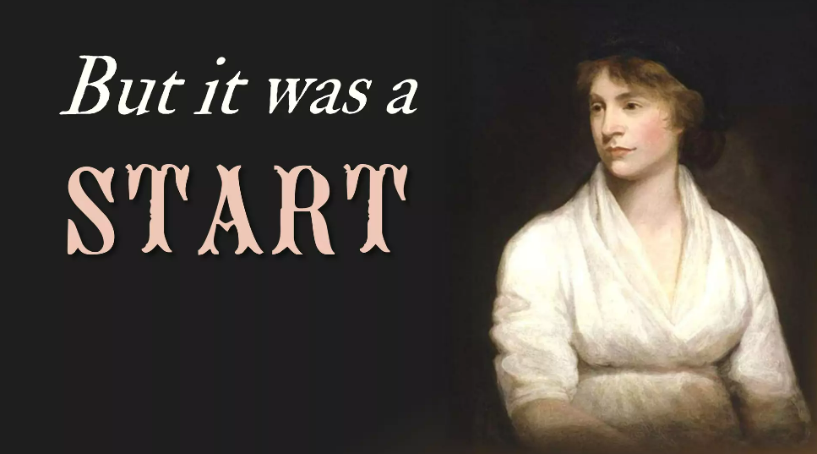
Notes:
1.Women suffrage movement .----19 th and 20th century
2.The feminist movement in 1960s and 70s
3.The United Nations Decade for women in 1975.

